Slide 1
2024 PIT: Counting Youth
How to conduct the 2025 PIT!

Slide 2
What is the Youth Count?
The Youth Count is blitz count of unaccompanied youth who are age 16-24 years of age who are unsheltered, unsafely housed, or couch hoping on a single night.

Slide 3
When is the Youth Count?
The Youth Count is counting where unaccompanied youth slept the night of January 22nd.

Slide 4
Remember it is ONLY a snapshot of who was homeless on a single night!
Notes:
Remember this is intended to be a comprehensive count only for the single night.
We recognize that it may not capture the entire needs that are in our region.

Slide 5
Who do we count for the Youth Count?
Youth ages 16-24 years of age who are unaccompanied.
Unaccompanied means they are living without another adult (person age 25 years or older).
A Youth household may be
Single-Youth who are single or a part of a couple, but with NO children.
Family-Youth who have children as a single or with a partner.
Youth cannot be living with an adult over age 25 years of age to be included in the Youth Count!

Slide 6
Who do we count for the Youth Count?
Youth who are literally homeless
Sleeping outside
Sleeping in a shelter
Sleeping in a vehicle
Sleeping in a place not meant for human habitation
Staying in a safe house
In a hotel paid by a program
Unaccompanied youth living in any of the following situations:
Staying w/ a friend/family on their couch or floor.
Staying in an unsafe situation just to have housing. (abusive, exposed to dangerous or other unsafe behaviors)
Trading sex for housing.
Staying somewhere against their will.
Youth in a hotel.

Slide 7
Who NOT to count?
Households with utilities that are temporarily shut off
Youth in institutions or treatment facilities.
Youth traveling (staying in car or tent a couple nights while traveling) if they have a destination where they will have housing.
Youth in transitional housing or permanent housing programs.

Slide 8
Conducting the Survey
The survey can be found at this link

Slide 9
Steps to Conducting Surveys
Your Role
Step 1: Complete the PIT if the Youth is unsheltered
Step 2: Explain what you’re doing & get consent
Step 3: Conduct the interview using the survey form
Step 4: Close the interview
Step 5: Record what you heard and observed

Slide 10
Step 1: Complete the PIT survey if unsheltered
Your Role
Rember that any youth who is unsheltered should first complete the PIT Live or PIT paper survey.

Slide 11
Step 2: Explain what you’re doing & get consent
Explain why you are conducting the Youth Count using the script.
Ask for consent to answer your questions.
If they give consent, continue with the interview. If they don’t, thank them for their time, and use the observation form.
Hello, today we are conducting a special survey of youth who a living in unsheltered or unstable housing situations to better understand the needs of youth in our region. This data will be used to develop a community plan to prevent and end youth homelessness.

Slide 12
Step 3: Conduct the interview
You can conduct the interview via a paper form or online.
Go through each question in the survey form.
Remember: people have the right not to answer all questions!
Add any notes that may be helpful
Example: If a youth is says they are not homeless or unstably housed but states they don’t feel safe at home due to an abusive or alcohol partner or parent.
Conduct second survey if more than one youth in household.

Slide 13
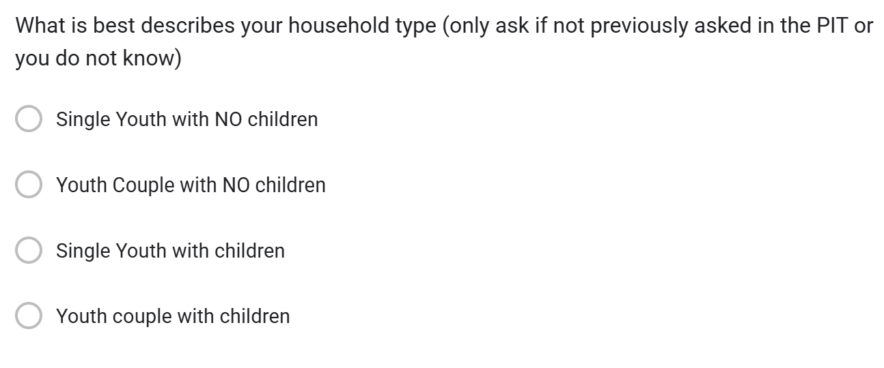
Household Type.

Slide 14
Assessment of housing situation.

Slide 15
Educational Status

Slide 16
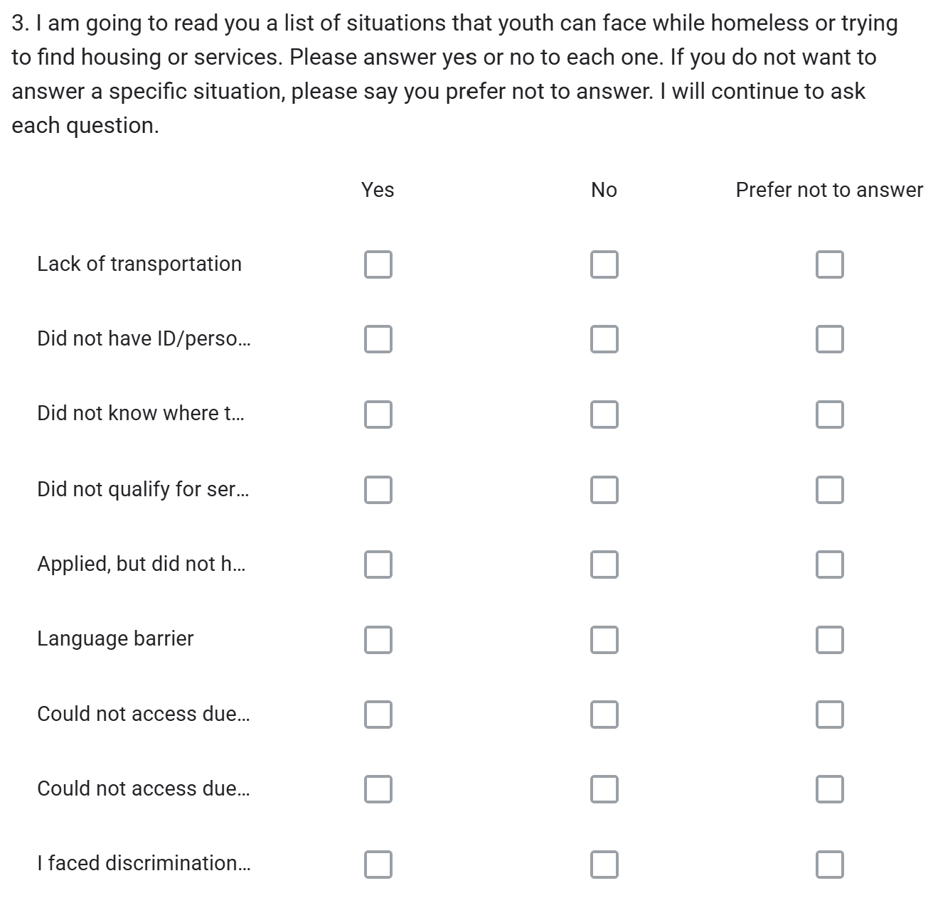
Sensitive Situations
This is a list of situations that youth who are homeless or unstably housed may encounter.
Please emphasize that you only need YES or NO answers.
Youth do not need to answer, but share that answers help us better understand situations that youth encounter and ways to better support youth.

Slide 17
Other obstacles
This question is designed to identify any additional obstacles that you may face that were not previously mentioned.
If none, please enter none or N/A.

Slide 18
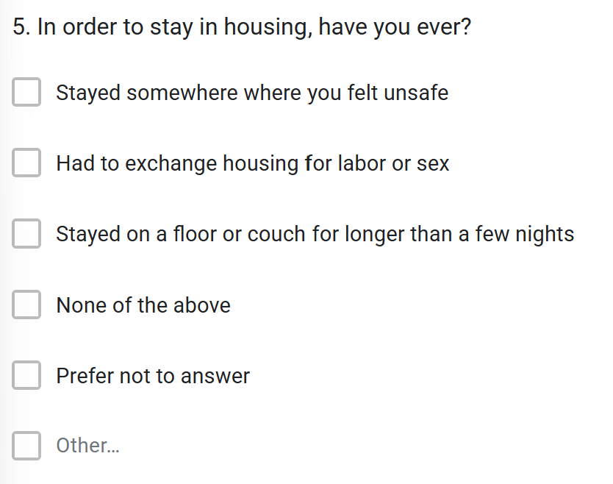
Sensitive living arrangements.
This questions is intended to identify what unsafe situations that youth have had to stay in due to no where else to stay.

Slide 19
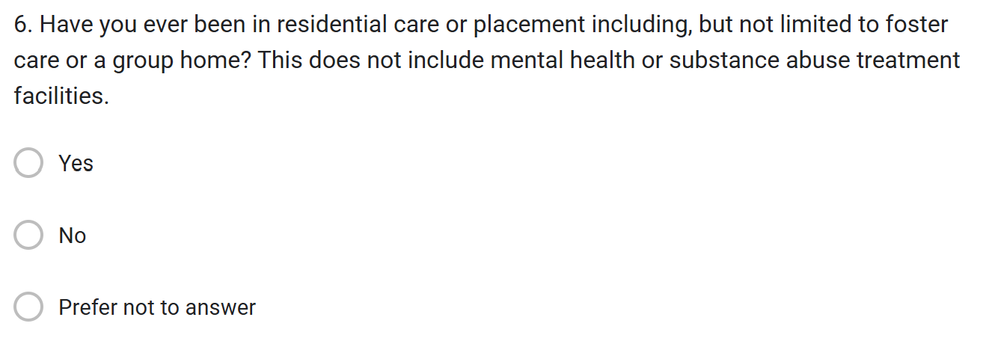
Placement
This question is to understand how may youth have engaged with Public Child Welfare.

Slide 20
Solutions
This question is to help identify what youth feel would help them find and keep housing.

Slide 21
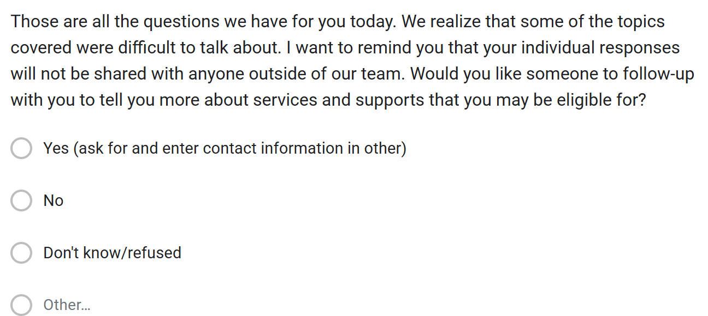
Follow-up
This question is to identify if youth want someone to follow-up with them after the survey.
Tell youth that this may take a day or more.

Slide 22
Step 5: Record what you heard and observed
Your Role
Complete the county the survey is taking place in.
Take a few minutes after your conversation to double check that you’ve completed the whole survey form
Include any additional notes or details.
Review the survey to make sure everything you have written is readable if using the paper form and that all answers are complete.
When complete, submit the survey online (either immediately or within 48 hours).
Notes:
If you are submitting online you can wait to hit submit to review your answers if you wish.

Slide 23
Step 4: Close the interview
Your Role
Thank the person for their time
Refer them to any services or resources they may have asked about or may need.
Offer everyone a resource sheet / contact card

Slide 24
Qualities of an effective interviewer
Qualities | Applying the Qualities
Objectivity | Approach survey participants without bias. Avoid inserting your own personal views or expectations into the survey process. Remain friendly, but neutral.
Patience | Avoid asking the questions too fast. Ensure that the interviewee has finished answering the last question before moving on. Do your best to remain calm and understanding during the survey. Ask a team member for assistance if needed.
Communication | Ask questions clearly and accurately. Listen thoughtfully to the responses of participants and consider how their answer fits best into the response options on the survey. Do not assume. Do not insert you own stories or experiences.
Confidential | Respect the privacy of survey participants. Do not share any personal information with your friends, family or colleagues. If you hear something that concerns you, speak to your PIT Leader or CoC Coordinator.
Compassion | Avoid judgement. Recognize that homelessness is for many a difficult and trying situation. Be compassionate but avoid temptations to become overly personal with survey participants. Be particularly sensitive to the possibility that the interview itself may, if it brings up bad memories, create some distress.
Maintain boundaries | Respect boundaries. Do not disclose your personal information. Do not offer services that you can not follow through on.
Detail-Orientated | Place close attention to the survey instructions. Capture the experiences of the survey participants, while following the questions as written.

Slide 25
Confidentiality
To assure you are maintaining respect and not violating laws, it is essential that you do NOT share the names, locations or personal data on those you encounter during the survey with friends, co-workers or family.
Understanding that your volunteer experience may be stressful and new experience, please talk with your peer volunteers or count coordinator to assure you debrief following your experience.
All surveyors must complete the Volunteer Agreement!

Slide 26
Final Key points!
Treat all persons you interview with respect!
Review all surveys to be sure they are complete.
Return all Surveys to your CoC Coordinator or County Leaders.
Within 4 days of the count, ALL forms must be entered online.
Connect people to resources as available – but don’t make promises.
If someone is outside attempt to connect them to shelter.
If someone is a veteran attempt to register them and connect to the VA
Provide information on community resources.

Slide 27
Notes:
Last but certainly not least…..Dress Warm, Have Fun and THANK YOU!

