Slide 1


2025 PIT: Counting those without shelter!
How to conduct the 2025 PIT!

Slide 2

What is a PIT Count?
A snapshot of who is homeless on a single night!
It helps to understand the scope of homelessness and identify trends
It is the source of national data on the number and characteristics of people who are homeless in the U.S.
MN’s Plan to Prevent and End Homelessness uses PIT data as a main data tool to measure meeting the goals laid out in the Heading Home Plan.
Notes:
We do the PIT Count for a few different reasons… CLICK
1) It helps us to understand the scope of homelessness and identify trends so we can better target our resources, improve services, and identify gaps in service. CLICK
2) We use Data to Justify Current and new services and programs. Data helps us tell our story and make the case for more resources. It helps build awareness, political will and political support ( at the local, state and national level) to have the right programs and services funded to meet the identified need. CLICK
3) It is a Critical source of national data on the number and characteristics of people who are homeless in the U.S.
As we’ve already mentioned, the PIT count is a federal requirement.
Additionally, the PIT count is the main data source used for measuring national progress in meeting the goals in Opening Doors: the Federal Strategic Plan to Prevent and End Homelessness. And, PIT count data is provided to Congress on the general homeless population and subpopulations of homeless persons, including Veterans, families, chronically homeless individuals, and youth across the nation. This is why we collect it on a single night in January in MN. Brr!CLICK
4) Data collected through the PIT is used as one of the main tools to measure progress on our State’s Heading Home plan to Plan to Prevent and End Homelessness.

Slide 3



There are two parts to the Point-in-Time (PIT) Count!
Sheltered | Unsheltered
Who is filling sheltered beds? The number and characteristics of households and people in sheltered programs. | Who is unsheltered? The number and characteristics of people in locations not meant for human habitation.
Areas counted: Emergency shelter Domestic Violence Transitional housing | Areas counted: Outside Public locations Known service locations Emergency locations
Data used? HMIS & PIT Live | Data used? PIT Live
Notes:
The annual PIT count is broken down into two distinct, yet related counts.
The PIT, or point in time count, includes a single day count of persons who are unsheltered or who reside in shelter. The PIT collects the number and characteristics of persons who are in emergency shelter, domestic violence programs, and transitional housing AND those who sleeping in places not meant for human habitation. This includes persons who primary or only location to stay is outside, in their vehicles, in public locations, in sheds, in ice houses, or in housing that has or should be condemned. The PIT collects data in HMIS and PIT live for those in shelter and PIT live for those who are unsheltered.

Slide 4

When is the PIT?
The PIT is a blitz count of persons who are unsheltered from dusk on the 22nd to dawn on the 23rd.
Notes:
We are collecting data for where people slept the night of January 24^{h}
It is a blitz or point-in-time count so we are only counting where people slept on that single night.
We can and will count for the two days following, but only capturing where people slept on the night of the count.

Slide 5
Remember it is ONLY a snapshot of who was homeless on a single night!
Notes:
Remember this is intended to be a comprehensive count only for the single night.
We recognize that it may not capture the entire needs that are in our region.

Slide 6
For the rest of this training, we will be focusing on the unsheltered PIT!
Notes:
For the rest of this training we will be focusing on the unsheltered PIT.

Slide 7
Who do we count for the Unsheltered PIT?
Persons who are staying in a place not meant for human habitation including persons who slept in one of the following without other safe housing options.
  Outdoors
  In a vehicle
  In a building not intended for residency (shed, icehouse, storage unit, abandoned building)
  A condemned home
  A home without utilities (not including those just temporarily shut off)
  Tent

Slide 8
Who NOT to count?
Persons doubled up
Persons in a motel paid via self pay or friends/family
Households with utilities that are temporarily shut off
Persons staying in homeless programs
Persons in institutions
Persons traveling (staying in car or tent a couple nights while traveling)
Notes:
While these situations are sometimes not considered safe or ideal, HUD does not consider them to be unsheltered so are not to be counted in the unsheltered PIT.
Do not count person who are doubled up with family or friends
Do not count persons in a motel in which they are paying for themselves. Those in a motel paid for by a church, agency, or law enforcement can be counted as part of the sheltered count.
Do not count persons staying in sheltered locations will be counted in the sheltered count (HMIS or Aggregate Survey).
Do not count people who are traveling – this mostly applies to finding someone in a rest area or parking lot sleeping. We need to discern whether they have a car full of items due to living in their car or moving.

Slide 9
Important Terms to Know before we start!
Adult: Age 25 and older
Young Adult: Age 18-24 years
Child: Under age 18
Respondent/First Respondent: Person answering the questions
Household: The people who live with you now or most of the time.
Household ID: The combination of letters used to identify and to link respondents together.
Doubled-up: People temporarily staying in a family or friend's home.
Notes:
While these situations are sometimes not considered safe or ideal, HUD does not consider them to be unsheltered so are not to be counted in the unsheltered PIT.
Do not count person who are doubled up with family or friends
Do not count persons in a motel in which they are paying for themselves. Those in a motel paid for by a church, agency, or law enforcement can be counted as part of the sheltered count.
Do not count persons staying in sheltered locations will be counted in the sheltered count (HMIS or Aggregate Survey).
Do not count people who are traveling – this mostly applies to finding someone in a rest area or parking lot sleeping. We need to discern whether they have a car full of items due to living in their car or moving.

Slide 10
Other things to know before we start!
The CoC Code is MN-508 West Central MN
All the “Surveyor Questions” must be completed
Never put the address of a domestic violence provider in the “Specific Location”
A respondent does not have to answer any question they don’t want to and can end the survey at any point.
You should still turn in partially completed surveys.
It is possible to conduct the survey directly through the PIT LIVE portal. However, if you interview households, you will need to track the Household ID of the first respondent (i.e., write it down) to link the household together. If you use a phone or tablet to survey, keep in mind that cold weather drains batteries quickly. Have a backup method handy (and a charger).
Notes:
While these situations are sometimes not considered safe or ideal, HUD does not consider them to be unsheltered so are not to be counted in the unsheltered PIT.
Do not count person who are doubled up with family or friends
Do not count persons in a motel in which they are paying for themselves. Those in a motel paid for by a church, agency, or law enforcement can be counted as part of the sheltered count.
Do not count persons staying in sheltered locations will be counted in the sheltered count (HMIS or Aggregate Survey).
Do not count people who are traveling – this mostly applies to finding someone in a rest area or parking lot sleeping. We need to discern whether they have a car full of items due to living in their car or moving.

Slide 11
Household ID Composition
All respondents within one household should be identified by the same Household ID
Correct Household ID composition
  CoC + First 3 letters of the First Respondent's First Name + First 3 letters of the First Respondent's Last Name
If you conduct the survey in PIT LIVE for a household you will need to track the Household ID of the first respondent (i.e., write it down) to link the household together.
Notes:
While these situations are sometimes not considered safe or ideal, HUD does not consider them to be unsheltered so are not to be counted in the unsheltered PIT.
Do not count person who are doubled up with family or friends
Do not count persons in a motel in which they are paying for themselves. Those in a motel paid for by a church, agency, or law enforcement can be counted as part of the sheltered count.
Do not count persons staying in sheltered locations will be counted in the sheltered count (HMIS or Aggregate Survey).
Do not count people who are traveling – this mostly applies to finding someone in a rest area or parking lot sleeping. We need to discern whether they have a car full of items due to living in their car or moving.

Slide 12
Conducting the Survey

Slide 13
Steps to Conducting Surveys
Your Role
Step 1: Approach & Introduction
Step 2: Explain what you’re doing & get consent
Step 3: Conduct the interview using the survey form
Step 4: Close the interview
Step 5: Record what you heard and observed
Notes:
Keep in mind that folks who’ve been living in unsheltered locations for a long time may identify that location as a “safe place to sleep,” so it is important to verify whether or not that “safe place” is sheltered if the person says they have one.
The call-out box at the bottom includes one way that people might consider approaching people and introducing themselves. It can be edited if you see fit to change that phrasing.
Reminder to avoid labeling people as homeless. You should not go up to someone and say, “Hey, are you homeless?” Instead, ask about where they are sleeping that night.

Slide 14

Step 1: Approach & Introduction
Your Role
Approach the person and introduce yourself
Find out if they are unsheltered. Remember persons do not always fit our stereotypes – don’t assumer someone is or is not homeless
If unsheltered, ask if the person has a few minutes to answer some questions
Keep in mind:
  You are entering someone's home
  Individuals sleeping outside may be dealing with active addiction, mental health concerns, and significant trauma histories. Do not sneak up on or startle people. Never shine flashlights in people’s faces.
  Maintain eye contact (if possible) and an open stance with your hands visible. Use a tone of voice that’s approachable. Speak slowly, be polite, and don’t shout.
Hi, my name is [name]. We’re out here trying to talk to folks who might not have a safe place to sleep tonight. Do you have a safe place to sleep tonight? Do you know where I might find some people around here who don’t?
Notes:
Keep in mind that folks who’ve been living in unsheltered locations for a long time may identify that location as a “safe place to sleep,” so it is important to verify whether or not that “safe place” is sheltered if the person says they have one.
The call-out box at the bottom includes one way that people might consider approaching people and introducing themselves. It can be edited if you see fit to change that phrasing.
Reminder to avoid labeling people as homeless. You should not go up to someone and say, “Hey, are you homeless?” Instead, ask about where they are sleeping that night.

Slide 15
Step 2: Explain what you’re doing & get consent
Explain why you’re there
Offer giveaways or incentives (i.e., socks, hand warmers, gloves, etc.)
If they consent to answering your questions, continue with the interview. If they don’t, thank them for their time, and use the observation form.
We’re conducting a survey, and your participation will help the community provide better services and resources for people who might not have a safe home or regular place to sleep at night. It’ll take about 4-5 minutes, you don’t have to answer any questions you don’t want to answer, and it’s all anonymous – meaning your name won’t be used. Are you willing to answer these questions?
Notes:
“After you’ve introduced yourself, explain what the PIT count survey is and ask if they’re willing to answer your questions. It’s extremely important to explain what you’re doing and to get the person’s consent or permission to participate before you start asking questions and recording their responses to the survey. Remember: everyone has a right to refuse to participate. The box at the bottom of this slide has an example of how you can do this. Does anyone have any ideas for how they would explain this work to someone? For those who have volunteered with us before, how have you phrased this part of your interviews? [allow time for volunteers to make suggestions and respond to each other’s suggestions.]”

Slide 16
Step 3: Conduct the interview
You can conduct the interview via a paper form or PIT Live.
Go through each question in the survey form.
  Remember: people have the right not to answer all questions!
Add any notes that may be helpful
  Example: If a person says that they have their own apartment, but they’re sitting on a bench outside of a 24-hour grocery store at 2:00 am with what appear to be all of their belongings, write down that you think there may be a discrepancy in what they are saying vs. where they will sleep that night.
Add family members as needed

Slide 17
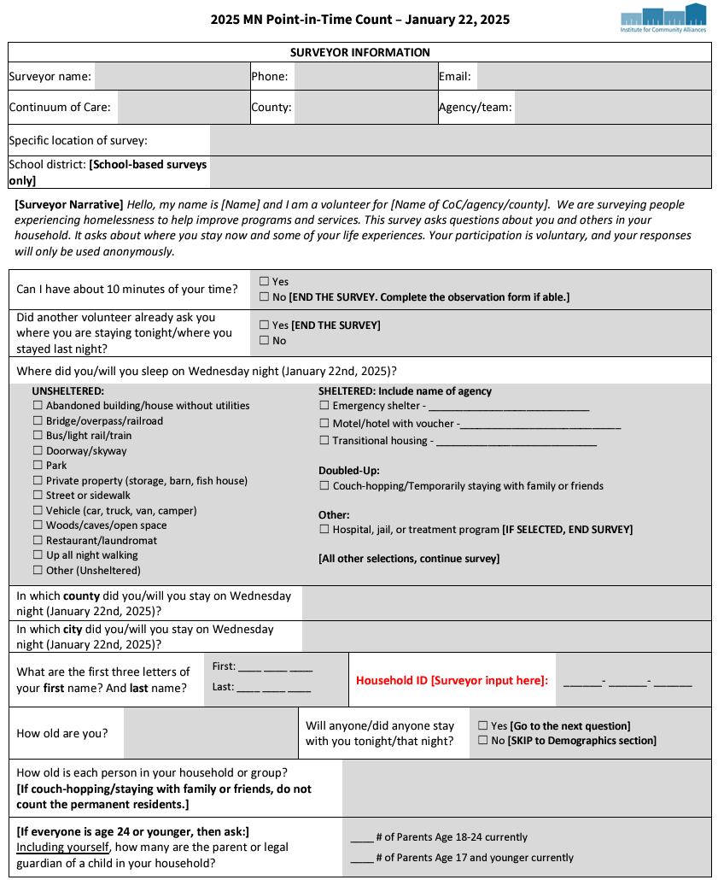
Unsheltered Survey Form
Surveyor Questions are used to reconcile or clarify questions. Surveyor name & contact is essential!
Read the intro script.
Where did you sleep on Wednesday night? If the person is in shelter or transitional housing you do not need to continue the reset of the survey. They will be captured in the sheltered survey. If it is a youth who is doubled-up, please end this survey and complete the youth survey.
We need to know the county and city!
The first three letters are used to de-duplicate and sort household.
Notes:
It is essential that everyone review all questions to make you comfortable with the tool.
The links are embedded in the PP

Slide 18
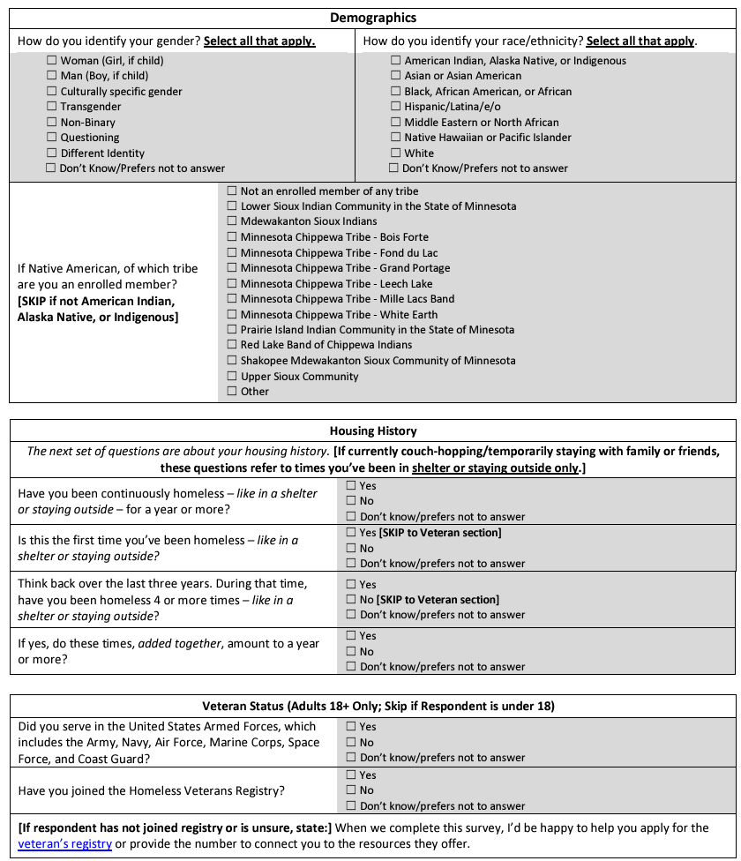
Unsheltered Survey Form
Complete all questions: (even if the answer is Don’t Know)
Demographics and Age are required by HUD. If this section is not answered, we may not be able to count the person. These are essential data elements and used to de-duplicate.
Housing History: These are also HUD required data elements. You can use motivational interviewing skills to help them identify the most correct answer to length of time and number of times homeless.
Surveyors answer combined time.
Veterans Status: Please use veterans one-pager to verify veteran status and offer to help people get registered or connect with the VA.
Notes:
It is essential that everyone review all questions to make you comfortable with the tool.
The links are embedded in the PP

Slide 19
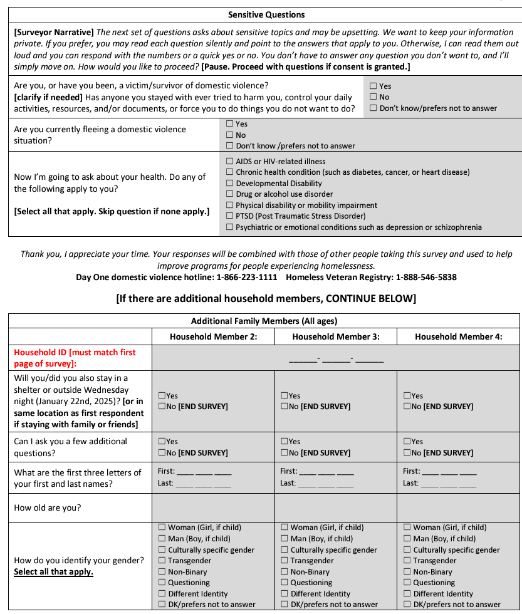
Unsheltered Survey Form
Sensitive Questions: Read the script before asking this section.
Yes or No answers are all that are required for the DV questions.
Offer to link them to crisis lines.
Additional Family Members: Complete for all
additional family members. A two-adult household without children may choose to each complete their
own survey or complete one as a family.
Notes:
It is essential that everyone review all questions to make you comfortable with the tool.
The links are embedded in the PP

Slide 20
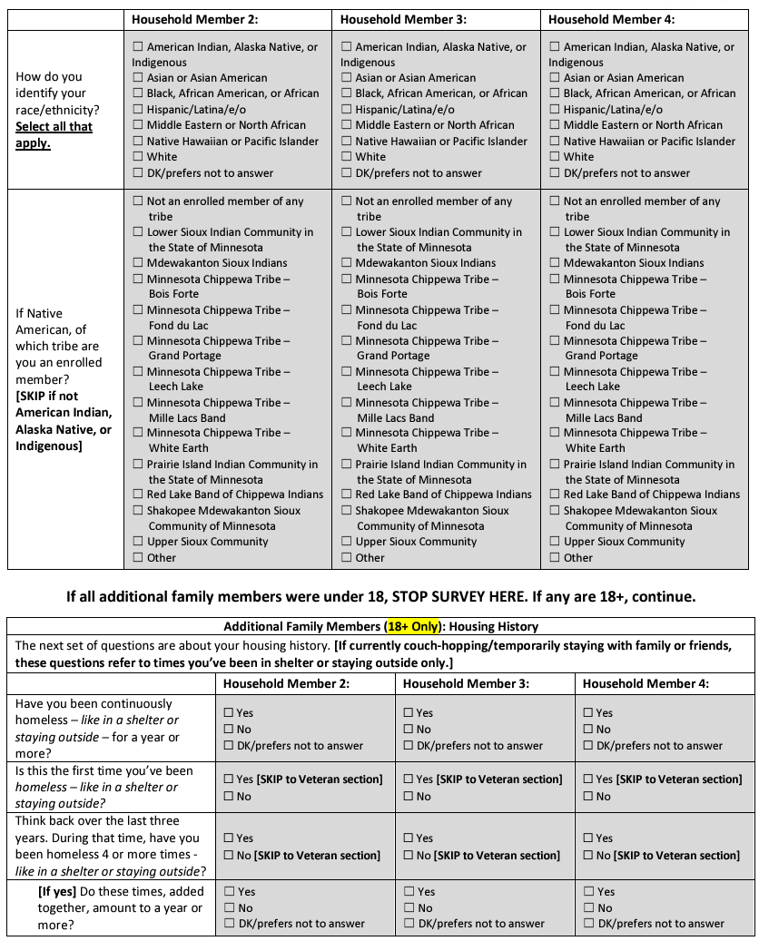
Unsheltered Survey Form
Additional Family Members continued : Complete for
all additional family members.
Adult (18+) only additional family members also ask this section: This section is about homeless history for members OVER age 18 years.
Notes:
It is essential that everyone review all questions to make you comfortable with the tool.
The links are embedded in the PP

Slide 21
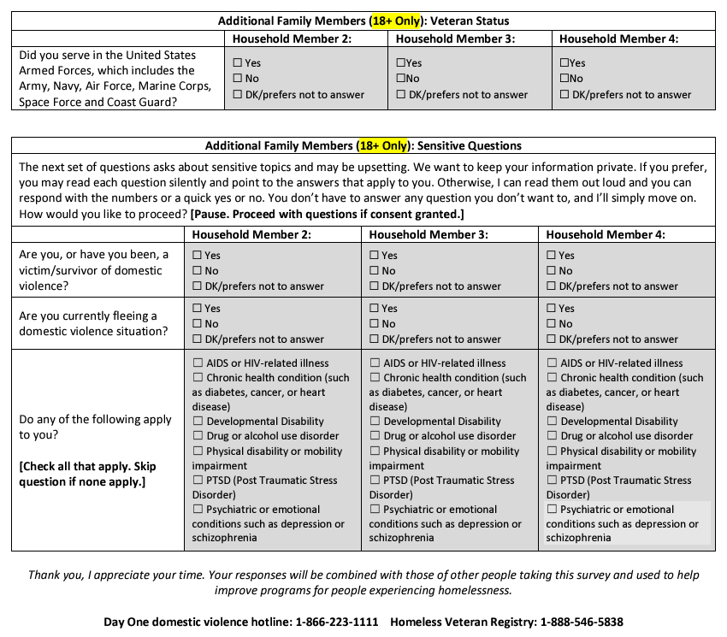
Unsheltered Survey Form
Additional Family Members 18+:
This page is also only for additional family members who
are over age 18 years! It includes veterans and sensitive questions.
Note the reminder to thank the person and give them Day One or the Veterans Registry number if needed.
Notes:
It is essential that everyone review all questions to make you comfortable with the tool.
The links are embedded in the PP

Slide 22
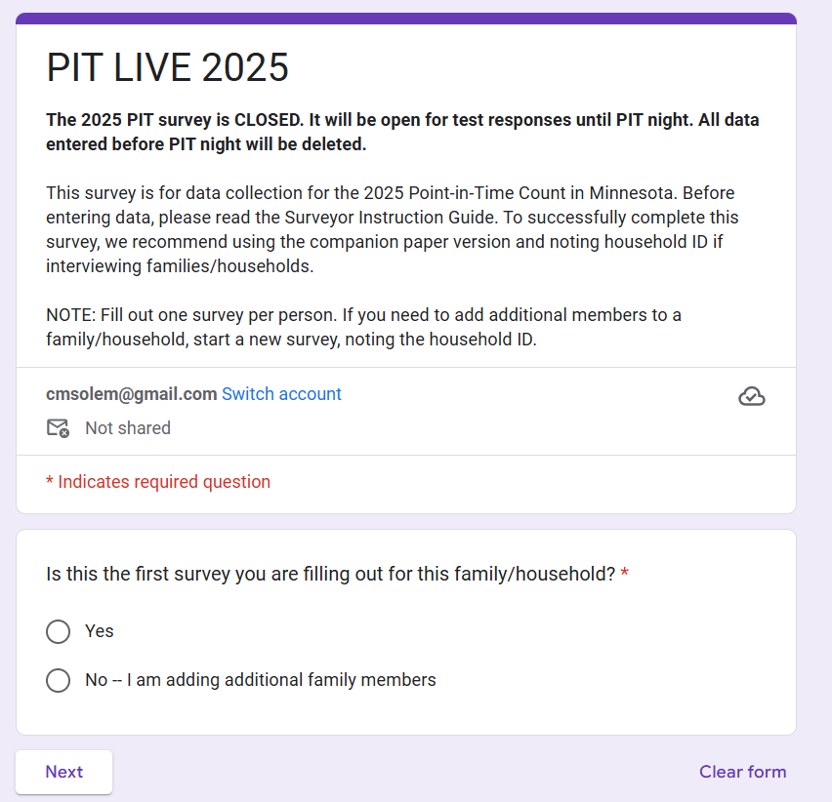
PIT Live!
Practice is essential!
Use this link to practice and to enter live surveys for the actual count.
Notes:
It is essential that everyone visit PIT LIVE at least once to make sure you do not have any issues accessing. Also, it is helpful to review all questions to make you comfortable with the tool.
The link is available by clicking on the PIT Live above.

Slide 23
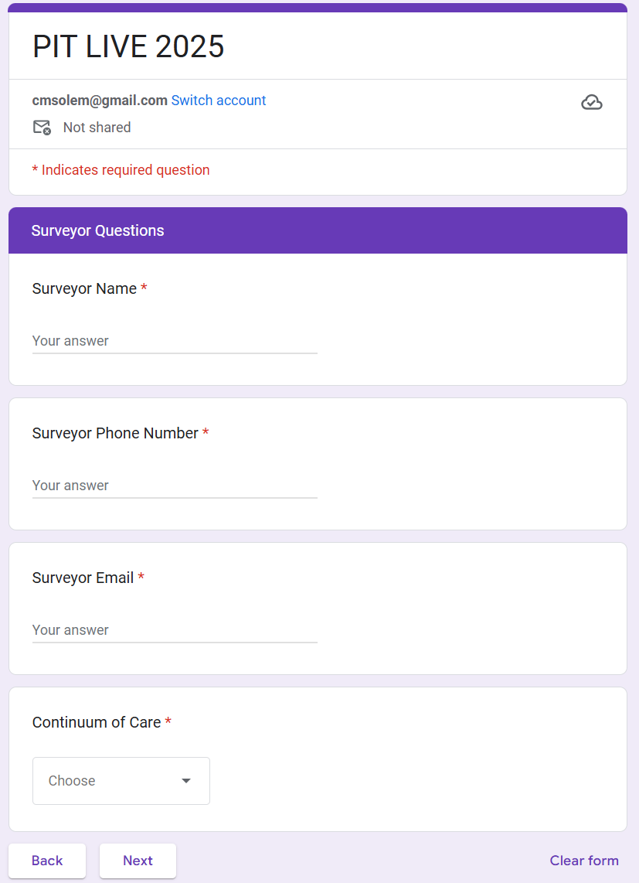
PIT Live!
Surveyor Questions are important
to reconcile and clarify!
All started questions must be
answered!
Notes:
It is essential that everyone visit PIT LIVE at least once to make sure you do not have any issues accessing. Also, it is helpful to review all questions to make you comfortable with the tool.
The link is available by clicking on the PIT Live above.

Slide 24
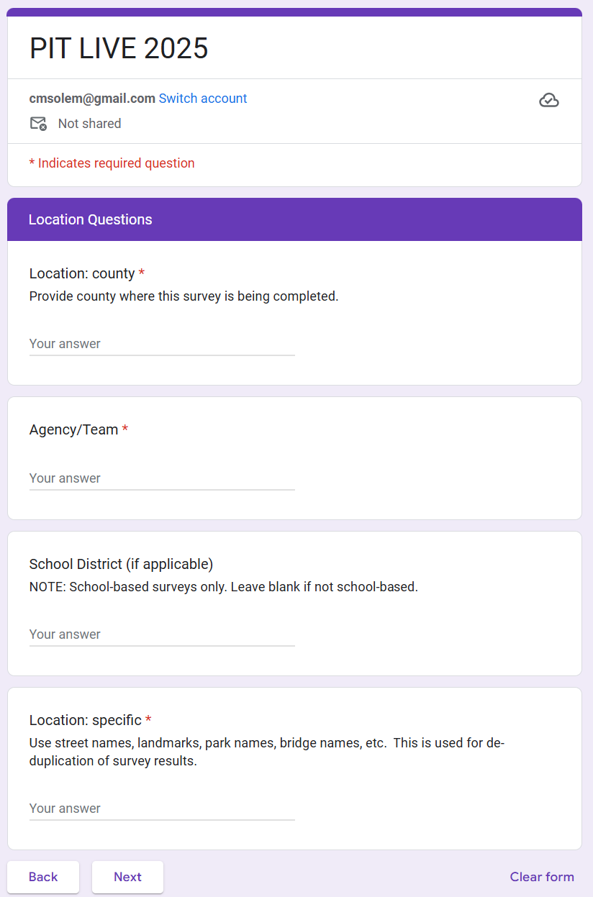
PIT Live!
This is where the survey is being completed –it may not be the same as where the person slept.
School district is answered only if conducted at school.
Location specific: Please fill this out! It is used to help de-duplicate and understand where people are.
Notes:
If you wish you can wait to hit submit until your review after you have left the encounter.

Slide 25
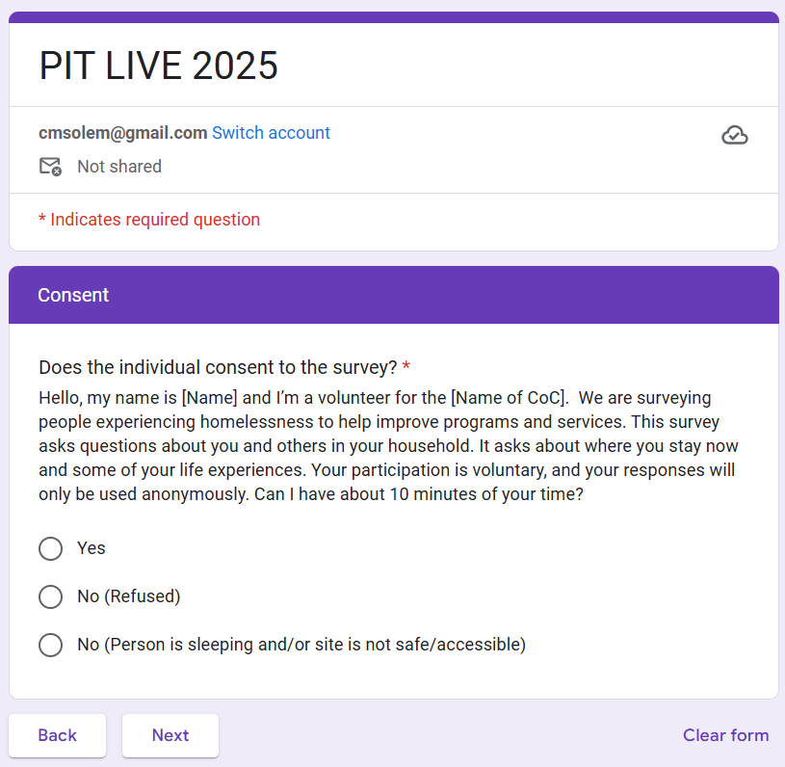
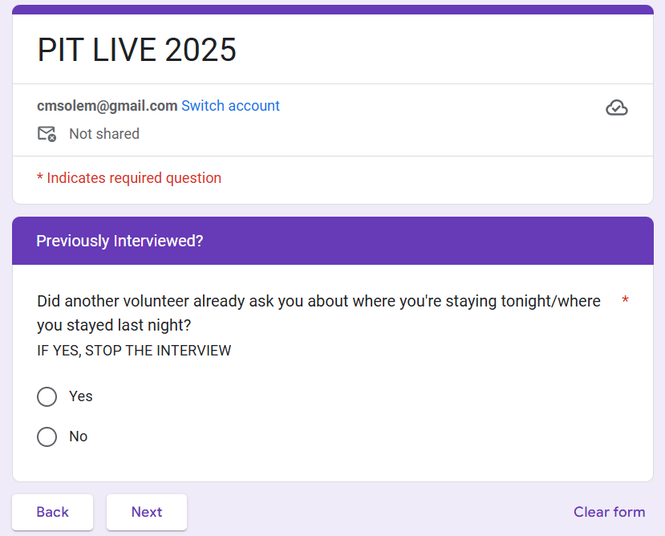
PIT Live! – Consent & if previously surveyed
Read the entire script. Stop if they have completed.
Notes:
If you wish you can wait to hit submit until your review after you have left the encounter.

Slide 26
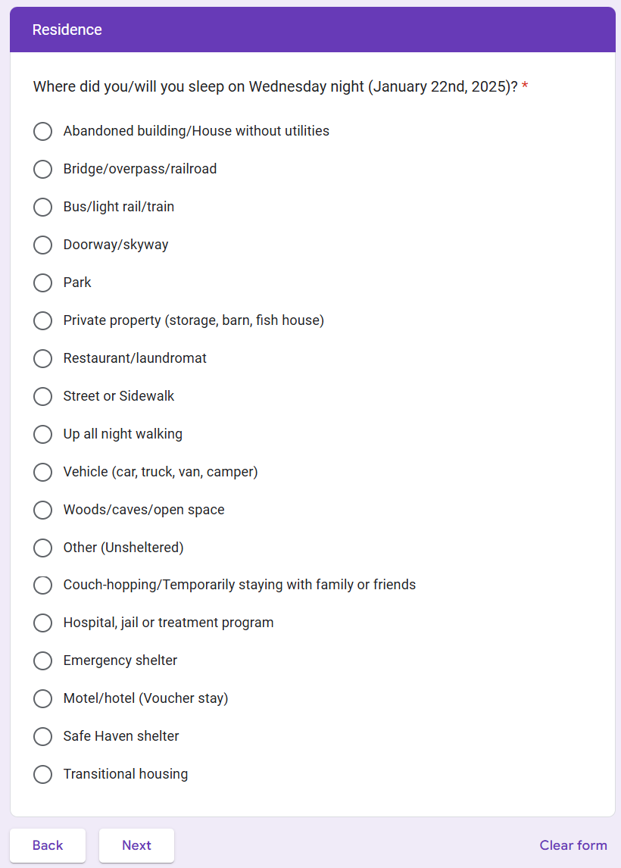
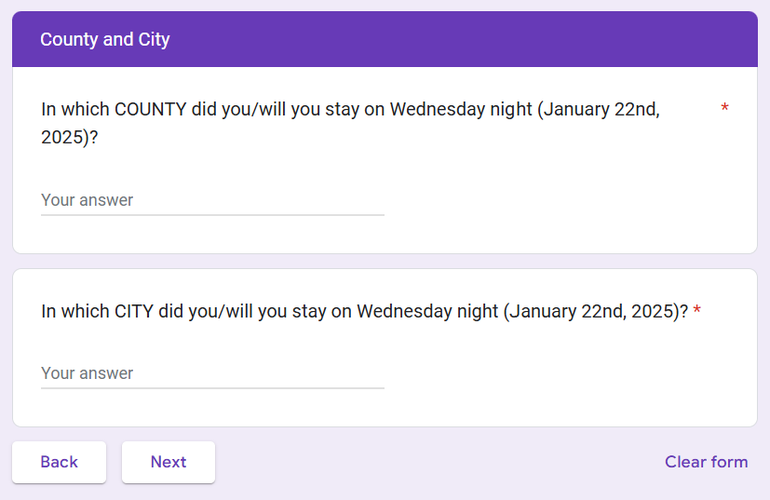
PIT Live! – Homeless status & location
This is where the person stayed on the night of the PIT. Note this may be in a different location than where they are interviewed and may even be outside of the CoC.
Notes:
If you wish you can wait to hit submit until your review after you have left the encounter.

Slide 27
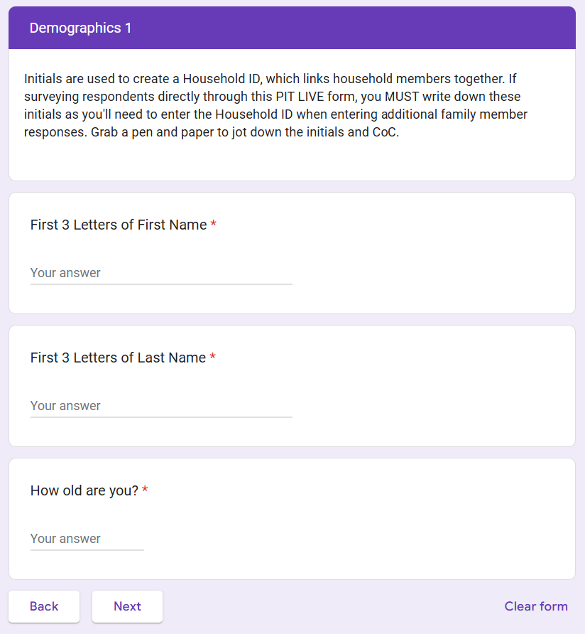
PIT Live! – Household ID
If the person does not want to give their first 3 letters. Have them choose a pets name. This is for de-duplication purposes ONLY.
Notes:
If you wish you can wait to hit submit until your review after you have left the encounter.

Slide 28
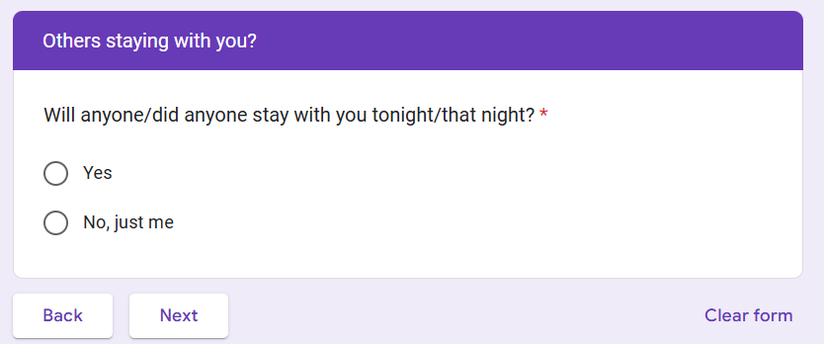
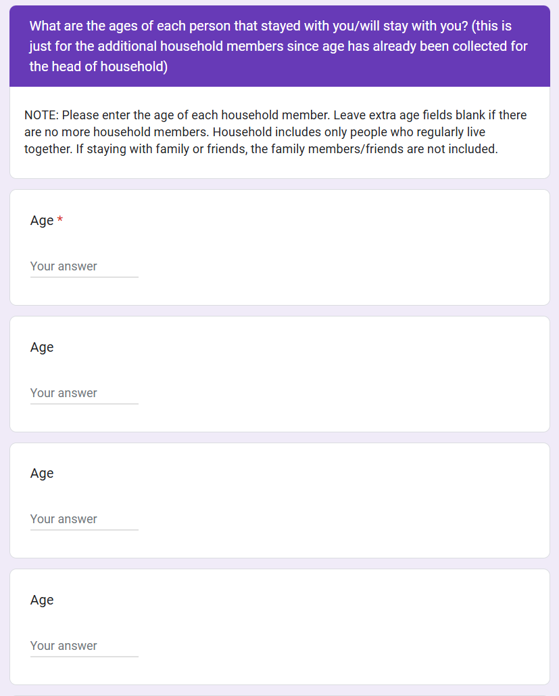
PIT Live! – Household type
This triggers whether additional household questions will pop up.
Notes:
If you wish you can wait to hit submit until your review after you have left the encounter.

Slide 29
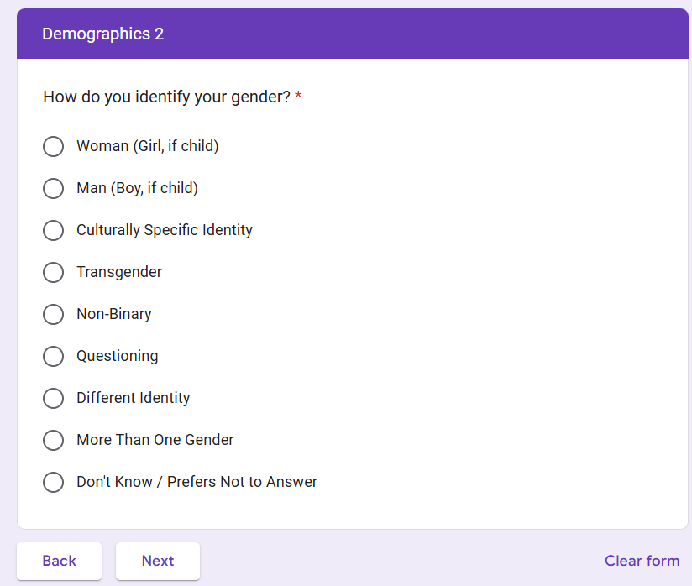
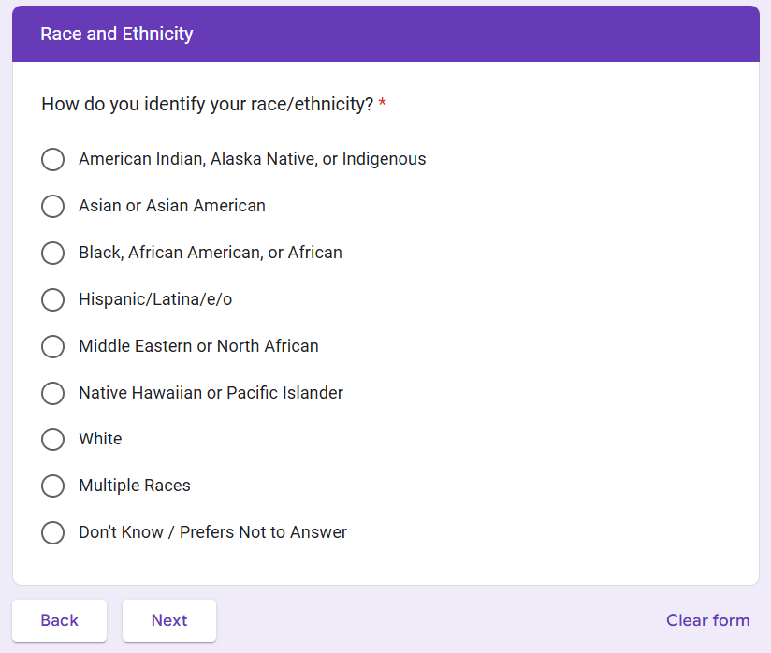
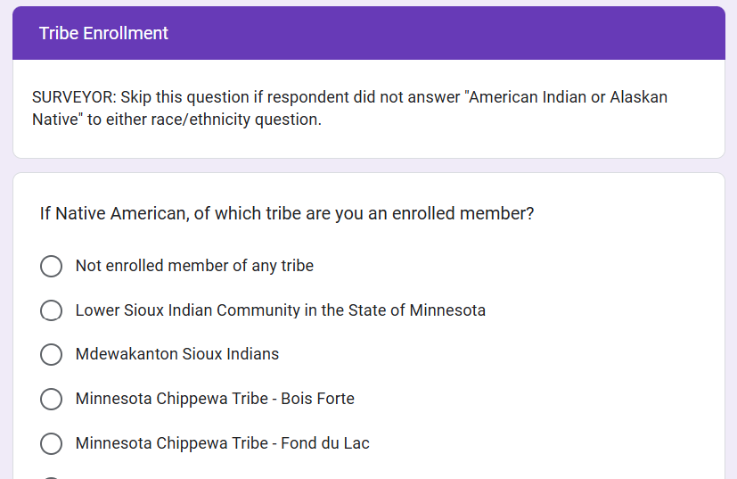
PIT Live! – Demographics
Do not assume gender identify. Ask. If they do not want to answer, then mark last circle.
Notes:
If you wish you can wait to hit submit until your review after you have left the encounter.

Slide 30
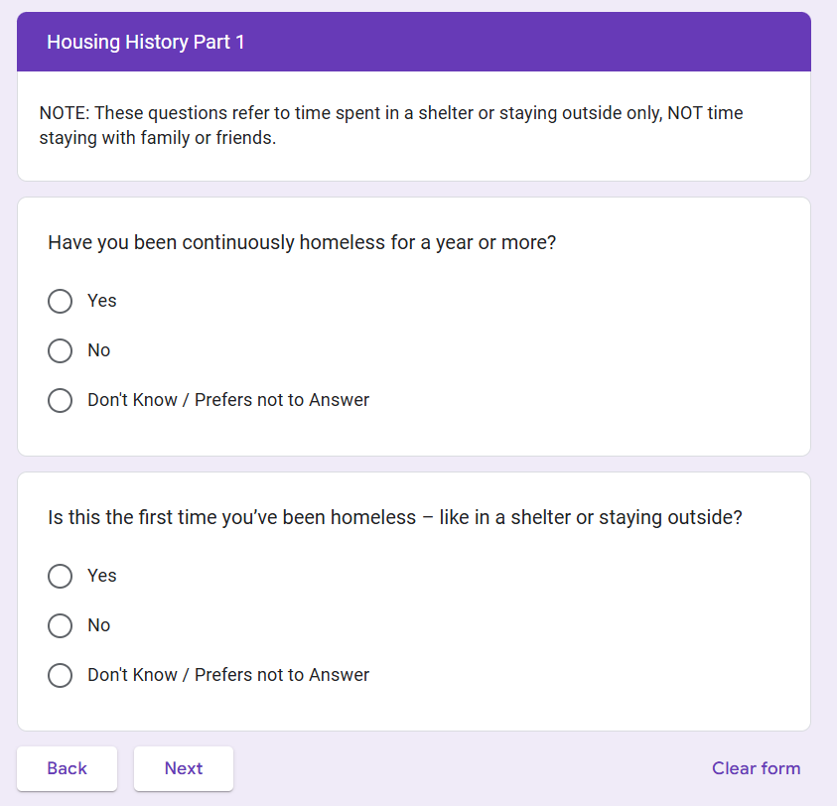
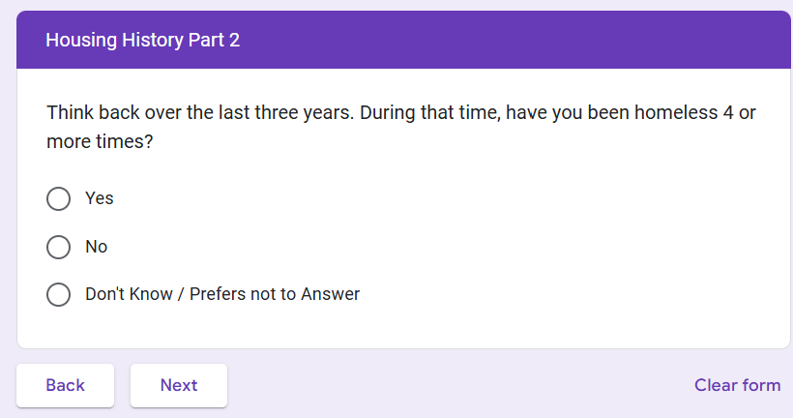
PIT Live! – Homeless history
This question can trigger a sub-question.
Notes:
If you wish you can wait to hit submit until your review after you have left the encounter.

Slide 31
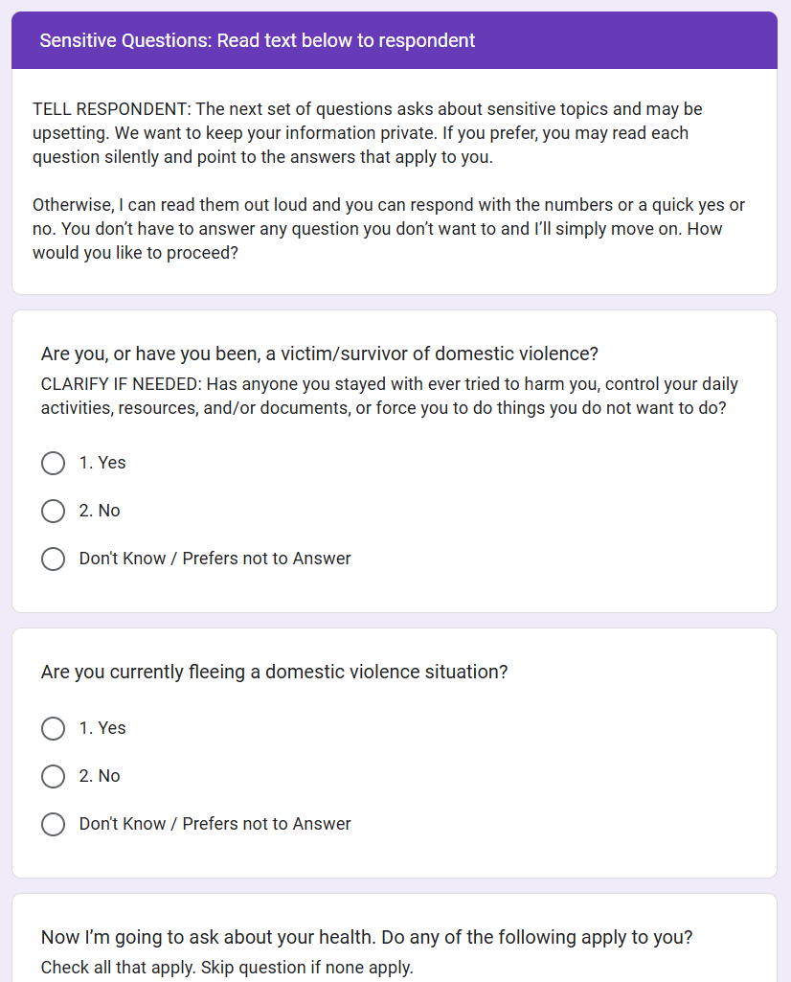
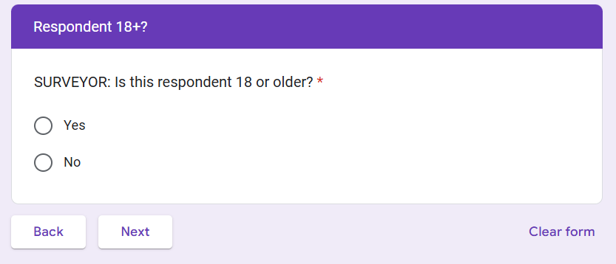
PIT Live! – 18+
Yes - triggers a series of homeless history, veteran status and sensitive questions for members over 18 years.
Notes:
If you wish you can wait to hit submit until your review after you have left the encounter.

Slide 32
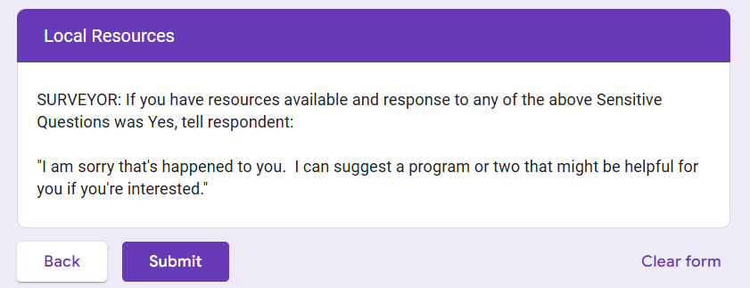
PIT Live! – End of Survey
Connect to local resources if the person has identified trauma, being a veteran or a survivor/victim. Use scripting to start the conversation.
You must hit submit for the survey to be entered.
Notes:
If you wish you can wait to hit submit until your review after you have left the encounter.

Slide 33
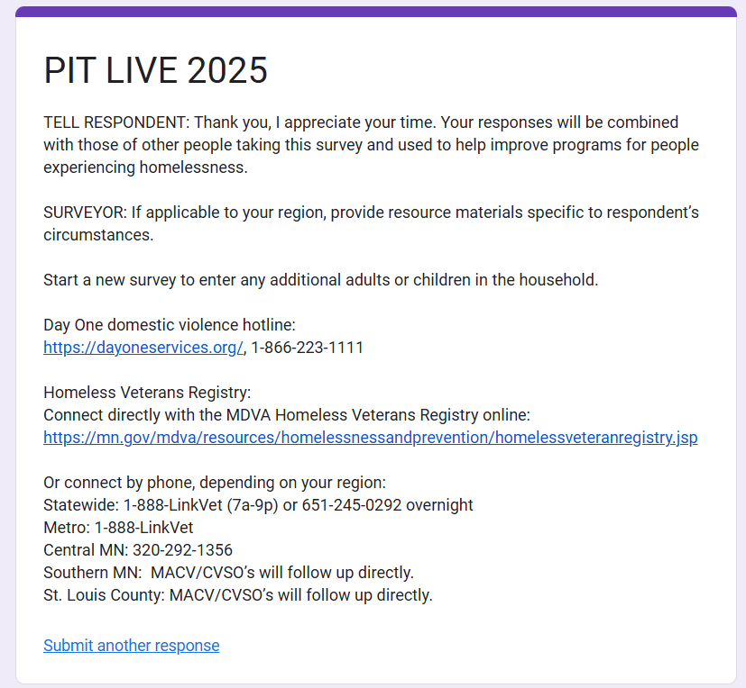
PIT Live!
Thank respondents!
Start a new survey if you have additional household members.
State resources.
You can submit another response via this link.
Notes:
If you wish you can wait to hit submit until your review after you have left the encounter.

Slide 34
Step 4: Close the interview
Your Role
Thank the person for their time
Refer them to any services or resources they may have asked about or may need.
  Offer everyone a resource sheet / contact card
  If they are a veteran, hand out the veteran’s sheet or assist with contacting the Veterans Registry.
Give them the incentive if you have not already done so.
Notes:
It can feel awkward to volunteers to end an interview if they haven’t given any thought to what to say after asking all of the questions. Do any of our returning volunteers have tips for how to end the interaction?
If shelter is an option please connect them to shelter.
Meal programs and the veterans registry are also important things to connect to.
If no shelter is available, it would be good to schedule a follow-up time to meet with an outreach staff or CARES assessor.

Slide 35
Step 5: Record what you heard and observed
Your Role
When complete, walk away from the person interviewed to a safe place. If doing multiple surveys in a row, try to make quick notes.
Take a few minutes after your conversation to double check that you’ve completed the whole survey form
Include any additional notes or details (paper version)
Review the survey to make sure everything you have written is readable (if using the paper form) and all answers are complete.
When complete, submit the survey online (either immediately or within 48 hours).
Surveys must be submitted online by the 31st.
Notes:
If you are submitting online you can wait to hit submit to review your answers if you wish.

Slide 36

Unsheltered Survey Quick Tips
Remember that you are speaking to highly vulnerable people and asking some very sensitive questions.
Notes:
“Before we dive into the survey forms, let’s start with a few general tips on how to conduct surveys. We’ll keep repeating some of these points throughout the day, but it’s important to start thinking about them now. First and foremost, always be respectful of the people you meet on the night of the count. Remember that they are vulnerable and that you’re asking some pretty personal questions. Be respectful of their choice not to answer any or all questions; it’s okay if someone refuses to participate. Getting their consent to talk to them and record their information is important. If they do consent to speaking with you, be sure to ask every question on the survey. It’s okay to skip the ones that they might answer for you earlier in the conversation. For example, maybe they tell you they’re a veteran before you ask, so you don’t need to re-ask them later when you get to that question. Finally, there may be some questions on the survey that feel a little awkward or uncomfortable to ask. It’s okay and normal to feel that way, but it’s important that you do ask all of the questions in the way we’ve phrased them. The gender question is a good example. A lot of people might think they can identify someone’s gender by looking at and talking to them, so rather than asking “How do you identify your gender?” they might instead want to say “OK, and so I can see that you’re male….” or “You’re male, right?” to someone they think is a man. There are a few reasons we don’t want you to do that: First, there are people who don’t identify as the gender they might most readily look like, and phrasing questions in a way that makes it seem like you think you know the answer is much more likely to lead to them saying “yep, that’s right,” rather than giving you the answer of how they identify. Second, there are many people who identify as something other than male or female or whose gender identity is different from what you might think it is when looking at them. They live in a world where people probably make assumptions about them every day, and each time someone repeats that kind of judgment, it could feel really harmful to the person you’re asking, and that kind of harm adds up to a lot over time. By choosing to ask everyone, “How do you identify your gender?” you are doing a service to those who wish others knew to ask that question in a more open-ended way, rather than assuming or prescribing their identity. This same premise applies to all of the questions on the PIT count survey.”

Slide 37
Unsheltered Survey Quick Tips
Remember that you are speaking to highly vulnerable people and asking some very sensitive questions.
Always lead with respect for the person you’re speaking with and respect for their dignity.
Notes:
“Before we dive into the survey forms, let’s start with a few general tips on how to conduct surveys. We’ll keep repeating some of these points throughout the day, but it’s important to start thinking about them now. First and foremost, always be respectful of the people you meet on the night of the count. Remember that they are vulnerable and that you’re asking some pretty personal questions. Be respectful of their choice not to answer any or all questions; it’s okay if someone refuses to participate. Getting their consent to talk to them and record their information is important. If they do consent to speaking with you, be sure to ask every question on the survey. It’s okay to skip the ones that they might answer for you earlier in the conversation. For example, maybe they tell you they’re a veteran before you ask, so you don’t need to re-ask them later when you get to that question. Finally, there may be some questions on the survey that feel a little awkward or uncomfortable to ask. It’s okay and normal to feel that way, but it’s important that you do ask all of the questions in the way we’ve phrased them. The gender question is a good example. A lot of people might think they can identify someone’s gender by looking at and talking to them, so rather than asking “How do you identify your gender?” they might instead want to say “OK, and so I can see that you’re male….” or “You’re male, right?” to someone they think is a man. There are a few reasons we don’t want you to do that: First, there are people who don’t identify as the gender they might most readily look like, and phrasing questions in a way that makes it seem like you think you know the answer is much more likely to lead to them saying “yep, that’s right,” rather than giving you the answer of how they identify. Second, there are many people who identify as something other than male or female or whose gender identity is different from what you might think it is when looking at them. They live in a world where people probably make assumptions about them every day, and each time someone repeats that kind of judgment, it could feel really harmful to the person you’re asking, and that kind of harm adds up to a lot over time. By choosing to ask everyone, “How do you identify your gender?” you are doing a service to those who wish others knew to ask that question in a more open-ended way, rather than assuming or prescribing their identity. This same premise applies to all of the questions on the PIT count survey.”

Slide 38
Unsheltered Survey Quick Tips
Remember that you are speaking to highly vulnerable people and asking some very sensitive questions.
Always lead with respect for the person you’re speaking with and respect for their dignity.
Ask all questions, unless the person has already given the answer to the question over the course of your conversation.
Notes:
“Before we dive into the survey forms, let’s start with a few general tips on how to conduct surveys. We’ll keep repeating some of these points throughout the day, but it’s important to start thinking about them now. First and foremost, always be respectful of the people you meet on the night of the count. Remember that they are vulnerable and that you’re asking some pretty personal questions. Be respectful of their choice not to answer any or all questions; it’s okay if someone refuses to participate. Getting their consent to talk to them and record their information is important. If they do consent to speaking with you, be sure to ask every question on the survey. It’s okay to skip the ones that they might answer for you earlier in the conversation. For example, maybe they tell you they’re a veteran before you ask, so you don’t need to re-ask them later when you get to that question. Finally, there may be some questions on the survey that feel a little awkward or uncomfortable to ask. It’s okay and normal to feel that way, but it’s important that you do ask all of the questions in the way we’ve phrased them. The gender question is a good example. A lot of people might think they can identify someone’s gender by looking at and talking to them, so rather than asking “How do you identify your gender?” they might instead want to say “OK, and so I can see that you’re male….” or “You’re male, right?” to someone they think is a man. There are a few reasons we don’t want you to do that: First, there are people who don’t identify as the gender they might most readily look like, and phrasing questions in a way that makes it seem like you think you know the answer is much more likely to lead to them saying “yep, that’s right,” rather than giving you the answer of how they identify. Second, there are many people who identify as something other than male or female or whose gender identity is different from what you might think it is when looking at them. They live in a world where people probably make assumptions about them every day, and each time someone repeats that kind of judgment, it could feel really harmful to the person you’re asking, and that kind of harm adds up to a lot over time. By choosing to ask everyone, “How do you identify your gender?” you are doing a service to those who wish others knew to ask that question in a more open-ended way, rather than assuming or prescribing their identity. This same premise applies to all of the questions on the PIT count survey.”

Slide 39
Unsheltered Survey Quick Tips
Remember that you are speaking to highly vulnerable people and asking some very sensitive questions.
Always lead with respect for the person you’re speaking with and respect for their dignity.
Ask all questions, unless the person has already given the answer to the question over the course of your conversation.
Always ask questions as they are written; do not ask questions in a way that shows you think you already know the answer.
  Example: Ask: “How do you identify your gender?” Do not ask: “You’re male, right?”
Notes:
“Before we dive into the survey forms, let’s start with a few general tips on how to conduct surveys. We’ll keep repeating some of these points throughout the day, but it’s important to start thinking about them now. First and foremost, always be respectful of the people you meet on the night of the count. Remember that they are vulnerable and that you’re asking some pretty personal questions. Be respectful of their choice not to answer any or all questions; it’s okay if someone refuses to participate. Getting their consent to talk to them and record their information is important. If they do consent to speaking with you, be sure to ask every question on the survey. It’s okay to skip the ones that they might answer for you earlier in the conversation. For example, maybe they tell you they’re a veteran before you ask, so you don’t need to re-ask them later when you get to that question. Finally, there may be some questions on the survey that feel a little awkward or uncomfortable to ask. It’s okay and normal to feel that way, but it’s important that you do ask all of the questions in the way we’ve phrased them. The gender question is a good example. A lot of people might think they can identify someone’s gender by looking at and talking to them, so rather than asking “How do you identify your gender?” they might instead want to say “OK, and so I can see that you’re male….” or “You’re male, right?” to someone they think is a man. There are a few reasons we don’t want you to do that: First, there are people who don’t identify as the gender they might most readily look like, and phrasing questions in a way that makes it seem like you think you know the answer is much more likely to lead to them saying “yep, that’s right,” rather than giving you the answer of how they identify. Second, there are many people who identify as something other than male or female or whose gender identity is different from what you might think it is when looking at them. They live in a world where people probably make assumptions about them every day, and each time someone repeats that kind of judgment, it could feel really harmful to the person you’re asking, and that kind of harm adds up to a lot over time. By choosing to ask everyone, “How do you identify your gender?” you are doing a service to those who wish others knew to ask that question in a more open-ended way, rather than assuming or prescribing their identity. This same premise applies to all of the questions on the PIT count survey.”

Slide 40
Unsheltered Survey Quick Tips
Remember that you are speaking to highly vulnerable people and asking some very sensitive questions.
Always lead with respect for the person you’re speaking with and respect for their dignity.
Ask all questions, unless the person has already given the answer to the question over the course of your conversation.
Always ask questions as they are written; do not ask questions in a way that shows you think you already know the answer.
  Example: Ask: “How do you identify your gender?” Do not ask: “You’re male, right?”
Everyone has the right to refuse to answer any or all of your questions.
Notes:
“Before we dive into the survey forms, let’s start with a few general tips on how to conduct surveys. We’ll keep repeating some of these points throughout the day, but it’s important to start thinking about them now. First and foremost, always be respectful of the people you meet on the night of the count. Remember that they are vulnerable and that you’re asking some pretty personal questions. Be respectful of their choice not to answer any or all questions; it’s okay if someone refuses to participate. Getting their consent to talk to them and record their information is important. If they do consent to speaking with you, be sure to ask every question on the survey. It’s okay to skip the ones that they might answer for you earlier in the conversation. For example, maybe they tell you they’re a veteran before you ask, so you don’t need to re-ask them later when you get to that question. Finally, there may be some questions on the survey that feel a little awkward or uncomfortable to ask. It’s okay and normal to feel that way, but it’s important that you do ask all of the questions in the way we’ve phrased them. The gender question is a good example. A lot of people might think they can identify someone’s gender by looking at and talking to them, so rather than asking “How do you identify your gender?” they might instead want to say “OK, and so I can see that you’re male….” or “You’re male, right?” to someone they think is a man. There are a few reasons we don’t want you to do that: First, there are people who don’t identify as the gender they might most readily look like, and phrasing questions in a way that makes it seem like you think you know the answer is much more likely to lead to them saying “yep, that’s right,” rather than giving you the answer of how they identify. Second, there are many people who identify as something other than male or female or whose gender identity is different from what you might think it is when looking at them. They live in a world where people probably make assumptions about them every day, and each time someone repeats that kind of judgment, it could feel really harmful to the person you’re asking, and that kind of harm adds up to a lot over time. By choosing to ask everyone, “How do you identify your gender?” you are doing a service to those who wish others knew to ask that question in a more open-ended way, rather than assuming or prescribing their identity. This same premise applies to all of the questions on the PIT count survey.”

Slide 41
Special Instructions

Slide 42
Counting Veterans
Persons answering that they are a Veteran on the night of the count must be verified! Call (701) 200-1013 (Fargo VA).
  Veteran’s full name, SSN, DOB, and branch of military, and contact information for follow-up is needed when calling.
  Leave message if no one is answering.
Follow-up support is available:
Fargo VA staff will be available via cell on the 23rd from 7 AM to 4:30 PM.
The Fargo VA Community Resource & Referral Center at 721 1st Avenue N. Fargo is open 8 AM -4:30 PM
Refer to MN Registry!
1-888-LinkVet (546-5838)
If assisting, use complete this release of information form.
  It is important to verify and connect veterans when possible!
Notes:
Verification of Veteran Status is required by HUD and helps assure we accurately understand veteran’s homelessness. Please be respectful, non-judgmental, and patient when verifying status. If possible, please check HMIS to verify sheltered veterans’ status. To verify unsheltered veterans or a sheltered veteran you are unsure about, call (701) 200-1013 (Fargo VA)
Fargo VA staff will be available on the 25th from 7 am to 4 pm. Messages can be left at all other times and the VA staff will return your call. Please speak clearly and leave as many details as possible, including a call back number for questions if needed. The Fargo VA resources center is open during regular hours.
All veterans should also be offered help with registering for the MN Veterans Registry to help them connect to stable housing and other eligible services. Veterans can choose to join directly by calling 1 (888) 546-5838
or surveyors can refer a Veteran to join by completing the release of information form.
Homeless Veteran Registry: 1-888-546-5838

Slide 43
Observation Form
Your Role
Only use when you cannot complete a survey with someone because they are sleeping (and you don’t wish to wake them), it is too dangerous, or the person will not answer any questions AND the person is clearly unsheltered.
Include as much detail as possible that helps to make the person identifiable and to provide clues on their housing status, but do not assume anything.
Link to Observation form.
Notes:
“Our observation form should only be used for the people you are not able to interview, so do not fill one out for the people you talk to and complete the survey with. We also ask on the survey form for you to fill in as much detail as possible about the person you’re observing. This will help us to figure out 2 main things: First, your description of what they look like and where they are will help us figure out whether or not that person has already been counted by another volunteer. So, after we’ve gotten all of the survey and observation forms back after the PIT count, we look to see if we see a description of someone wearing the same clothes or sleeping in a similar location on multiple forms. If there are multiple forms that seem to be counting the same person, the rest of the description will make it easier to tell whether it was the same person counted twice or two totally different people who were counted once. Second, your description of where they are, what they are doing, and what makes you think they may or may not be experiencing homelessness will help us to determine whether or not to count that person as “homeless” by HUD’s definition for the PIT count. So, for example, if you write that you saw someone sleeping on a park bench at 2 am, that would reasonably tell us that the person is experiencing homelessness.”

Slide 44
Step-by-Step Guide to Observations
Step 1: Approach, Introduction & Consent
Follow the same protocol you used with the interviews.
Only use the observation form if
  the person says they don’t want to answer your questions, or
  if they can’t for some reason (e.g., if they’re sleeping and waking them up is inappropriate or dangerous).
Always try to survey, including waking someone up if appropriate, unless it is too dangerous, or they refuse.
Notes:
“When you go to fill out the actual observation form, we want to know as much as possible about what you’re able to see. As we discussed earlier, this will help us to determine whether or not the person has been counted more than once by other volunteers, and it will help us determine whether or not they meet that definition of “homeless” that we talked about at the very beginning of this training. We want you to include as much detail as possible about what they look like, what they are wearing, what they have with them or near them, and why there was no survey completed with them. We want to know what makes you think they are or are not experiencing homelessness.”

Slide 45
Step-by-Step Guide to Observations
Step 2: Fill out the Observation Form
Write down as much detail as possible that helps to make the person identifiable and to provide clues on their housing status.
  What is the person wearing? (e.g., “Yankees baseball cap, navy GAP sweatshirt, jeans, and tan utility boots.” or “bundled in a grey, puffy sleeping bag that covered their face.”)
  What does the person look like? (e.g., “shoulder-length grey hair, white, female, 50-60 years old”)
  Why were you unable to complete a survey with them? (e.g., “They said they did not want to complete a survey, but they were awake.”)
  Where did you see them? (e.g., “On 20th St. NW between R St. and S St., sitting on the bench outside of X store.”)
  What makes you think that they are or may be experiencing homelessness? (e.g., “They were sleeping on a park bench with a large bag of their belongings next to them.”)
Notes:
“When you go to fill out the actual observation form, we want to know as much as possible about what you’re able to see. As we discussed earlier, this will help us to determine whether or not the person has been counted more than once by other volunteers, and it will help us determine whether or not they meet that definition of “homeless” that we talked about at the very beginning of this training. We want you to include as much detail as possible about what they look like, what they are wearing, what they have with them or near them, and why there was no survey completed with them. We want to know what makes you think they are or are not experiencing homelessness.”

Slide 46
Step-by-Step Guide to Observations
We cannot use observations if there is not enough information.
However, do not assume data (gender, age, race).
Notes:
“When you go to fill out the actual observation form, we want to know as much as possible about what you’re able to see. As we discussed earlier, this will help us to determine whether or not the person has been counted more than once by other volunteers, and it will help us determine whether or not they meet that definition of “homeless” that we talked about at the very beginning of this training. We want you to include as much detail as possible about what they look like, what they are wearing, what they have with them or near them, and why there was no survey completed with them. We want to know what makes you think they are or are not experiencing homelessness.”

Slide 47





How to be a good surveyor!

Slide 48
Qualities of an effective interviewer
Qualities | Applying the Qualities
Objectivity | Approach survey participants without bias. Avoid inserting your own personal views or expectations into the survey process. Remain friendly, but neutral.
Patience | Avoid asking the questions too fast. Ensure that the interviewee has finished answering the last question before moving on. Do your best to remain calm and understanding during the survey. Ask a team member for assistance if needed.
Communication | Ask questions clearly and accurately. Listen thoughtfully to the responses of participants and consider how their answer fits best into the response options on the survey. Do not assume. Do not insert you own stories or experiences.
Confidential | Respect the privacy of survey participants. Do not share any personal information with your friends, family or colleagues. If you hear something that concerns you, speak to your PIT Leader or CoC Coordinator.
Compassion | Avoid judgement. Recognize that homelessness is for many a difficult and trying situation. Be compassionate but avoid temptations to become overly personal with survey participants. Be particularly sensitive to the possibility that the interview itself may, if it brings up bad memories, create some distress.
Maintain boundaries | Respect boundaries. Do not disclose your personal information. Do not offer services that you can not follow through on.
Detail-Orientated | Place close attention to the survey instructions. Capture the experiences of the survey participants, while following the questions as written.

Slide 49

Counting in the Cold!
Dress for the weather!
  Wear layers
  Wear boots to keep feet dry as you walk through the snow
  Wear gloves under mittens so you can write but still stay warm if out for extended periods.
  Bring back-up clothing if you get wet.
Prepare for data collection
  Bring charger as batteries don’t last as long in cold
  Bring a clipboard to write on if doing a paper survey
  Bring extra pens as they too can be affected by cold.
There may be contingencies
  If there is a severe weather advisory, we may need to delay outreach.

Slide 50
Safety
While an accurate count is important, the safety of volunteers and persons being counted is primary!
Always travel in pairs, three people ideally. One person should be responsible for observing surroundings.
Outreach teams should include at least one experienced social worker, mental health worker, or law enforcement.
Understand that people may be defensive and NOT want to be interviewed. You are a stranger coming into their space. Do NOT push them.
Dress for the weather!
Have extra dry clothes and shoes if needed.
Wear bright colors so you are seen.
If someone's safety is a concern, contact law enforcement, medical care, or a VSP like Day One domestic violence hotline: 1-866-223-1111.

Slide 51
Respect
While an accurate count is important,
Understand that people may NOT want to be interviewed. Do NOT push them.
Be respectful. Even though outside or in their car, you are entering the person's “home”.
When approaching early morning, allow time for the person to adapt to waking up
Do not argue or question their answers.
When entering a camp or approaching a vehicle, approach slowl, calmly, and friendly. You are a stranger entering their space. Give them time to adjust and react.

Slide 52
Confidentiality
To assure you are maintaining respect and not violating laws, it is essential that you do NOT share the names, locations or personal data on those you encounter during the count with friends, co-workers or family.
Understanding that your volunteer experience may be stressful and new experience, please talk with your peer volunteers or count coordinator to assure you debrief following your experience.
All surveyors must complete the Volunteer Agreement!

Slide 53
Youth Count
If you encounter youth, ages 18-24 years of age who are not unsheltered, but identify as being double-up, couch hoping, or living in unsafe situations, please complete the youth count.
There is a separate training on the youth count.

Slide 54
Final Key points!
Treat all persons you interview with respect!
Review all surveys to be sure they are complete.
Return all Surveys and Veteran Registry Release Forms to your CoC Coordinator or County Leaders.
Connect people to resources as available – but don’t make promises.
  If someone is outside attempt to connect them to shelter.
  If someone is a veteran attempt to register them and connect to the VA
  Provide information on community resources.
Within 7 days of the count, ALL forms must be entered online. If you
need an extension please contact your count coordinator.

Slide 55
Dress Warm and Stay Safe!
Notes:
Last but certainly not least…..Dress Warm, Have Fun and THANK YOU!

